Slide 1

PRESENTATION ON
STACK
111111
1jbl
1
DATA STRUCTURE AND
ALGORITHM (DSA)
ADVANCED COLLEGE OF
ENGINEERING AND
MANAGEMENT
FEBRUARY 14 ,2023

Slide 2

2
Presentation Team
Aayush Chand
Bipin Ale Magar
Bimarsha Panta
Dipesh Dhungana
ACE077BCT005
ACE077BCT028
ACE077BCT027
ACE077BCT035

Slide 3
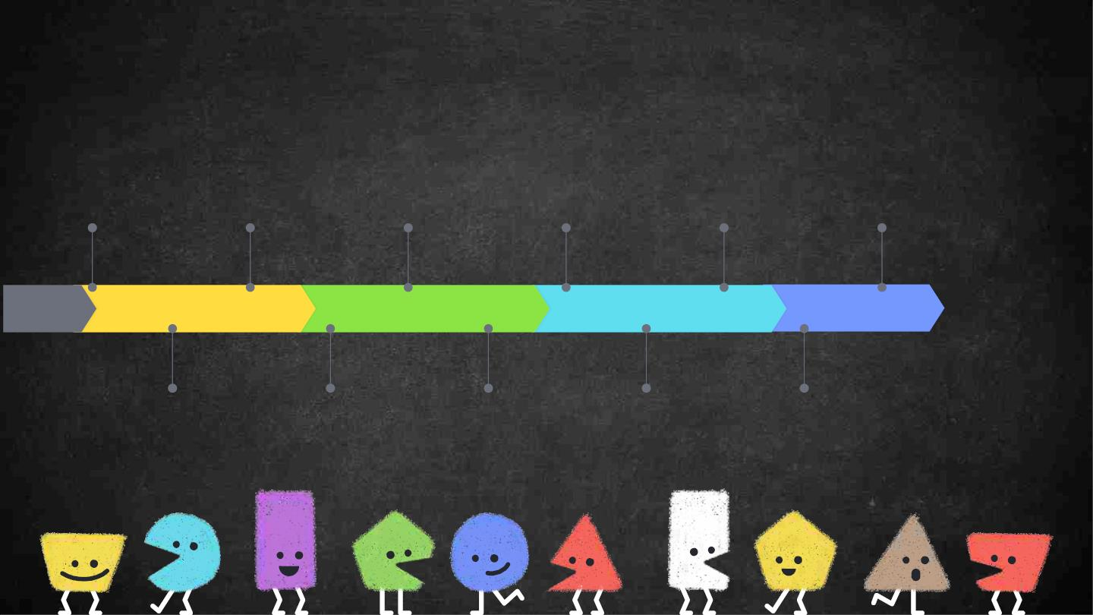
3
Timeline
DATA STRUCTURE
CLASSIFICATION
DATA STRUCTURE
APPLICATIONS
STACK
PUSH
PEEK
CODE EXECUTION
INTRODUCTION
ALGORITHMS
SOURCECODES
DATA STRUCTURE
SPECIFICATIONS
DEFINITION
VISUAL
REPRESENTATION
POP
ARRAY
REPRESENTATION OF
STACK IN C

Slide 4

DATA STRUCTURE
4
DATA STRUCTURE IS A TECHNIQUE OF ORGANIZING AND
STORING DATA ELEMENTS INTO COMPUTER MEMORY.
SPECIFICATION
1. ORGANIZATION OF DATA
2. ACCESSING METHODS
3. DEGREE OF ASSOCIATIVITY
4. PROCESSING ALTERNATIVES FOR INFORMATION
5. BUILDING BLOCKS OF PROGRAMS

Slide 5
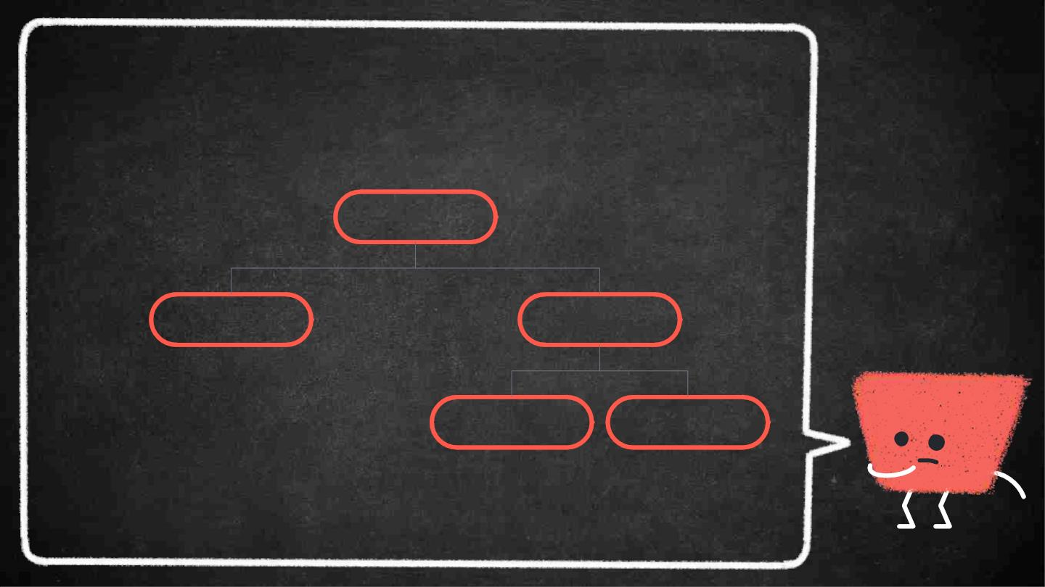
5
CLASSIFICATION
Data Structure
Primitive Data
Structure
Non Primitive Data
Structure
Linear Data
Structure
Non Linear Data
Structure

Slide 6

6
DATA STRUCTURE
PRIMITIVE
NON-PRIMITIVE
➜ Directly operated
upon by the machine
instructions
➜ Complex data structures
derived from primitive
data structures
➜ Examples : Integer,
➜ Examples : Linear and Non
Float, Character
-Linear

Slide 7
7
NON-PRIMITIVE DATA STRUCTURE
LINEAR
NON-LINEAR
➜ Elements are arranged
➜ Elements are not arranged
in linear order
in linear order
➜ Examples : Stack and
➜ Examples : Trees and
Queue
Graphs

Slide 8

“
8
Stack is a type of linear
data structure in which an
element may be inserted
or deleted only at one end
which is called as top of
the stack.

Slide 9
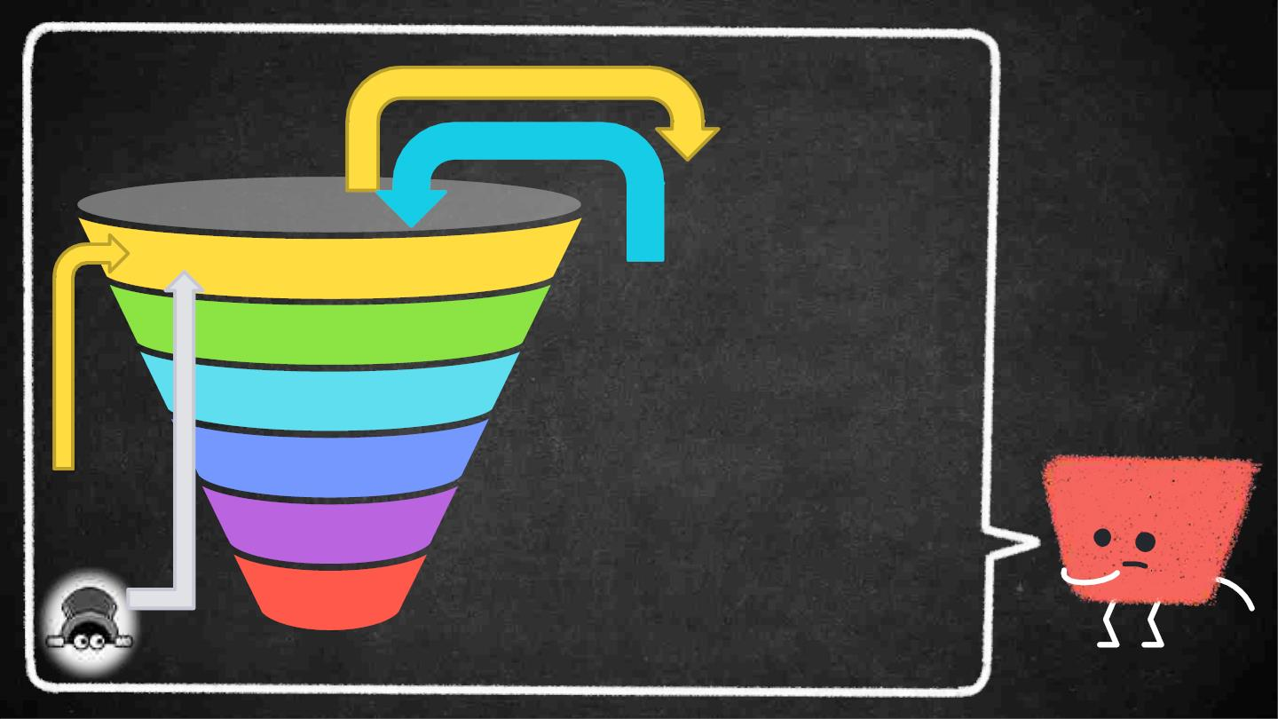
9
STACK
POP
DATA 6
DATA 5
DATA 4
DATA 3
DATA 2
DATA 1
PUSH
LIFO
TOP OF
THE
STACK
LAST IN FIRST OUT
PEEK

Slide 10
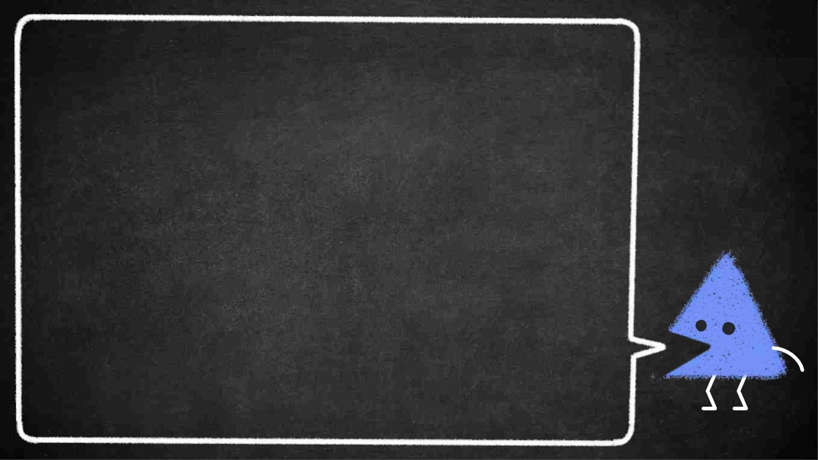
10
APPLICATION OF STACK
➜ Backtracking
➜ String Reversal
➜ Function Calls
➜ Expression Conversion
➜ Expression Evaluation

Slide 11
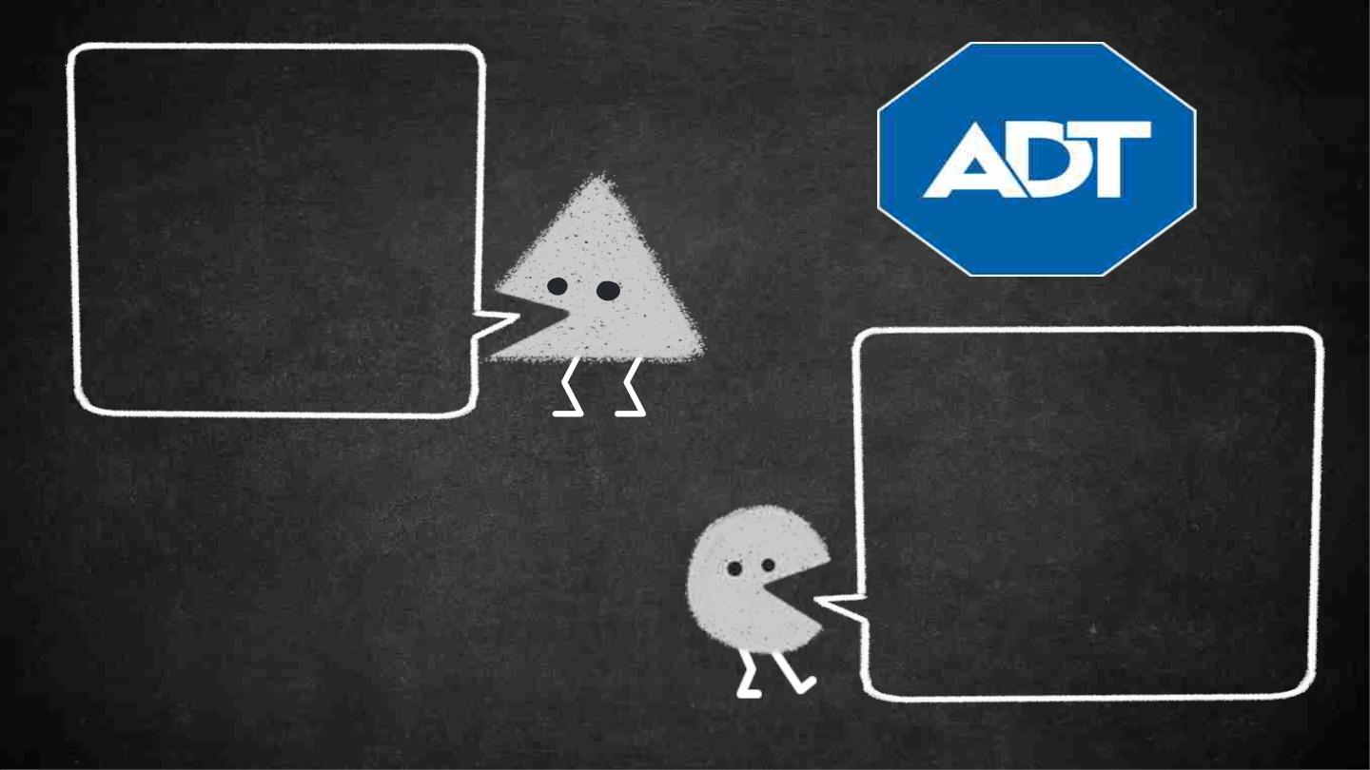
11
STACK OPERATION
1. PUSH
2. POP
3. PEEK
AN ABSTRACT DATA TYPE CONSISTS
OF A DATA TYPE TOGETHER WITH A
SET OF OPERATIONS WHICH DEFINES
HOW THE TYPE MAY BE MANIPULATED.
IT CONSISTS OF :
1. DECLARATION OF DATA
2. DECLARATION OF OPERATION

Slide 12

PUSH ALGORITHM
1. Start
2. Check for STACK OVERFLOW
3. If STACK OVERFLOW exists, then
print “STACK OVERFLOW !” and
exit the program
4. Else, Increase the top by 1
5. Read the data that is to be inserted
say “data”
6. Set the data to the top of the stack
7. Stop

Slide 13
POP ALGORITHM
1. Start
2. Check for STACK UNDERFLOW
3. If STACK UNDERFLOW exists, then
print “STACK UNDERFLOW !” and
exit the program
4. Else, Remove the data from the top of
the stack
5. Decrease the top by 1
6. Stop

Slide 14
PEEK ALGORITHM
1. Start
2. Check for STACK UNDERFLOW
3. If STACK UNDERFLOW exists, then
print “STACK UNDERFLOW !” and
exit the program
4. Else, Set I = top
5. Display the top of the element
6. Stop

Slide 15
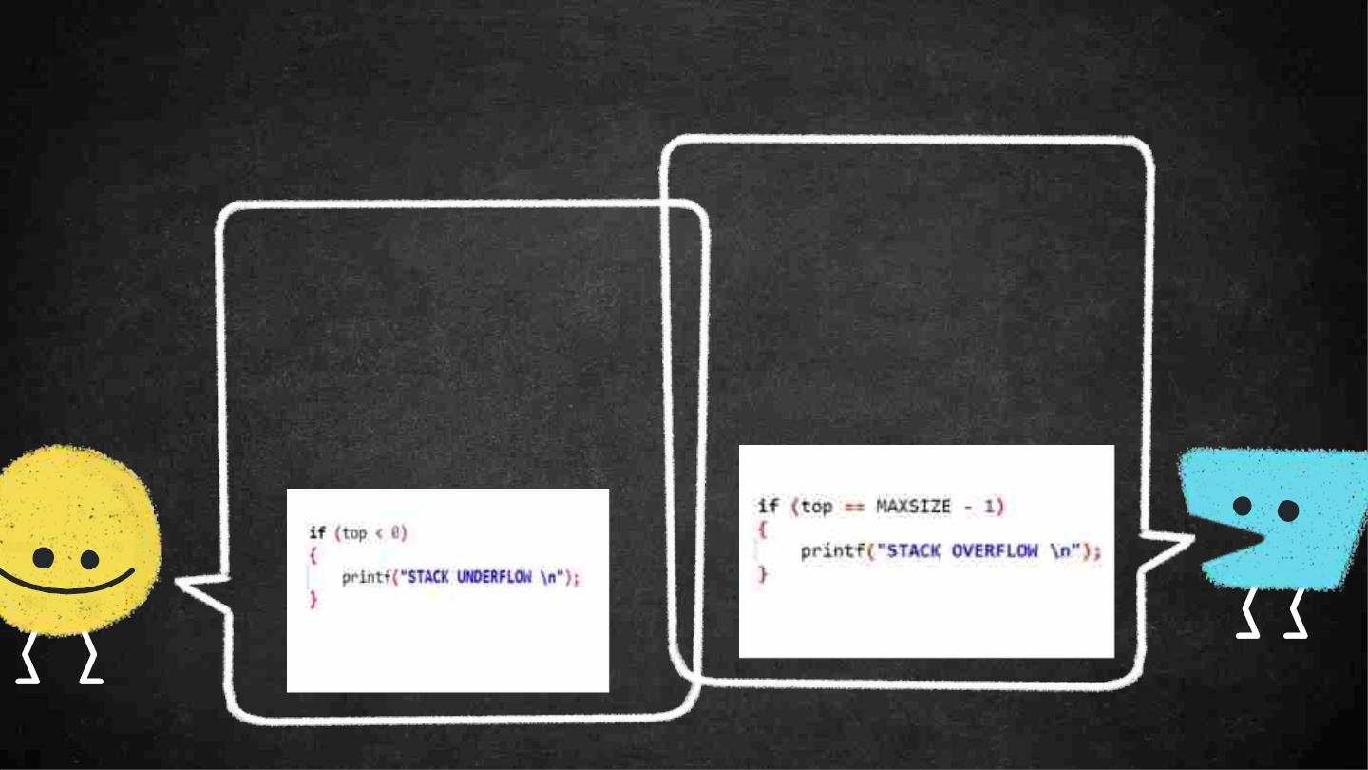
UNDERFLOW AND OVERFLOW
15
A STACK IS SAID TO BE IN
OVERFLOW STATE IF THE
STACK IS COMPLETELY
FULL.
A STACK IS SAID TO BE IN
UNDERFLOW STATE IF
THE STACK IS
COMPLETELY EMPTY.
OVERFLOW CHECK
UNDERFLOW CHECK

Slide 16

16
CODE SKELETON
Push
POP
PEEK
1
3
5
2
4
6
ISFULL
ISEMPTY
IS EMPTY

Slide 17
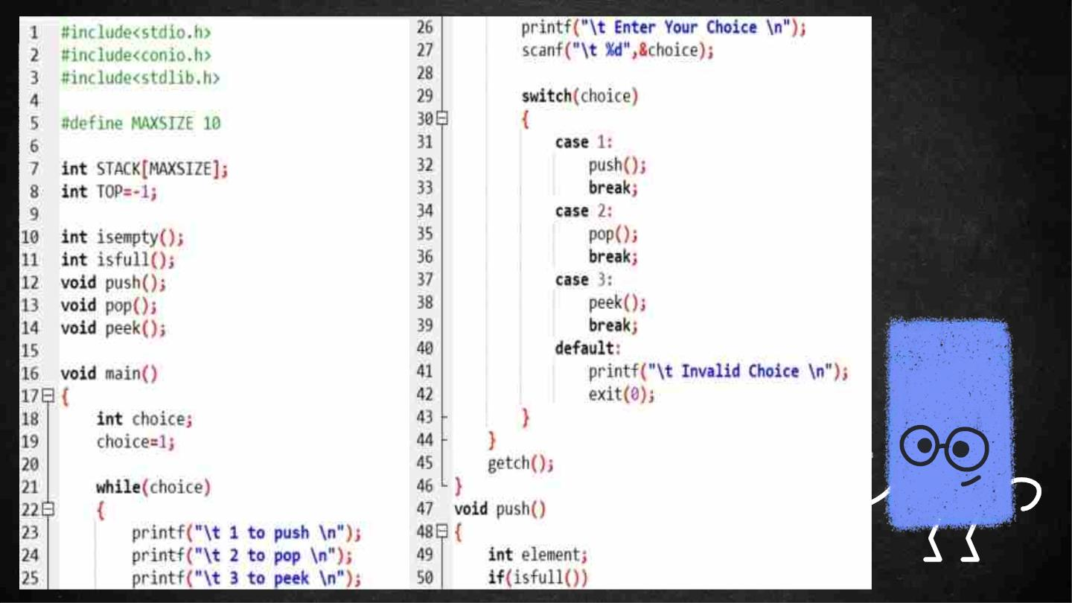
17

Slide 18
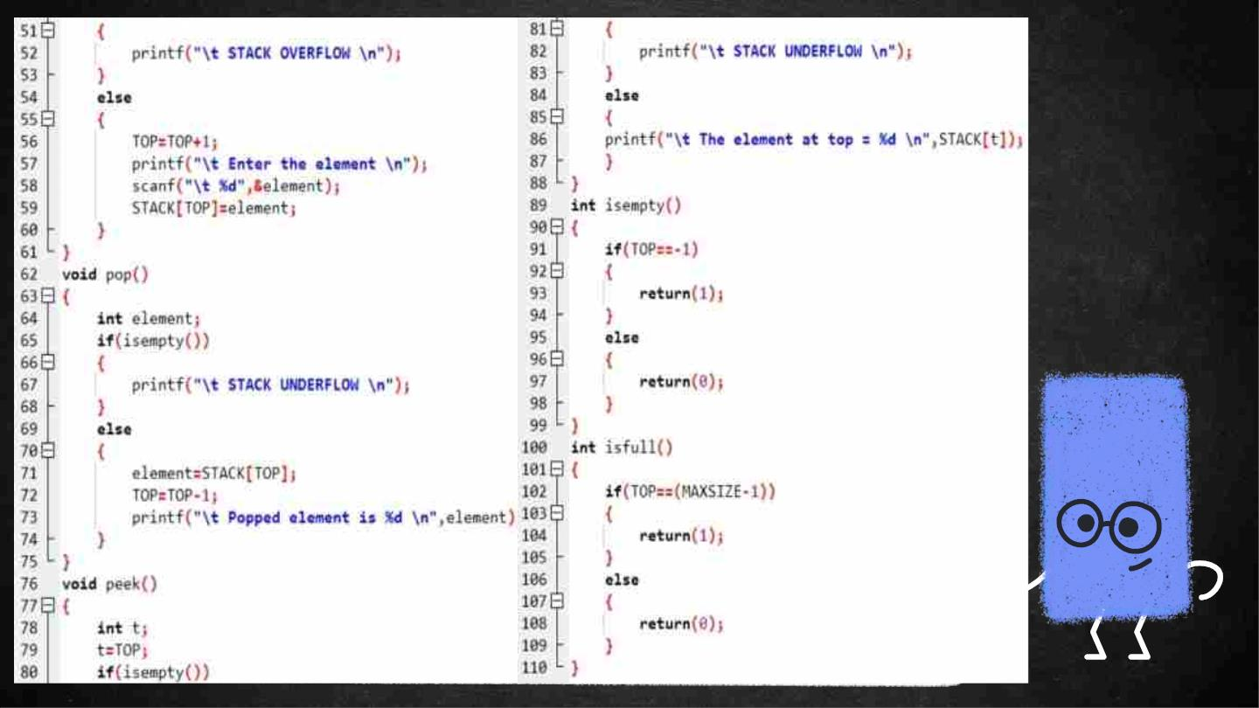
18

Slide 19
references
1. DATA STRUCTURE AND ALGORITHM NOTE COPY
- DHIRAJ PYAKUREL
2. DATA STRUCTURE THROUGH C
- G.S. BALUJA
3. INTERNET
https://chat.openai.com/chat

Slide 20

20
.

